Slide 1
Electrical module for surgical tables and procedure chairs
Edition: February 2019

Slide 2
Surgical module for surgical tables & procedure chairs - Electrical actuated 3-axis module -
Benefits:
Plug and play solution for tables and chairs
All electrical actuation with 24 V
Play free motion on tilting axis
Programmable control unit with 3 free channels
Compact module with attachment frames
High degree of lateral and longitudinal tilt
Column with very high lifting stroke
Safe components medical norm approved
Possibility to attach linear guides

Slide 3
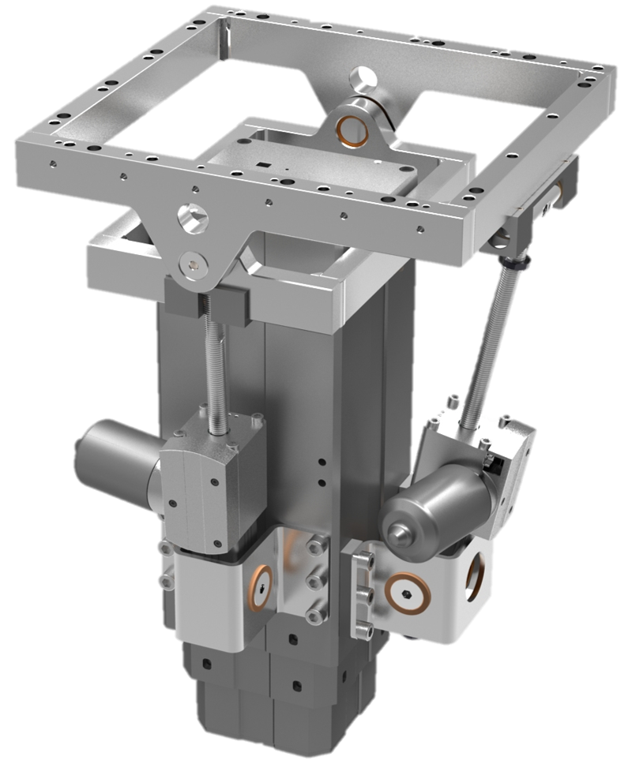
Surgical Module – Base information - Electrical actuated 3-axis module -
Outer frame with pivot axis
Inner frame with pivot axis
Longitudinal tilt actuator, series CAMT
Lateral tilt actuator , series CAMT
Lift column, series CPMT
Control unit, series SCU (not visible)
Operating device, series EHA (not visible)

Slide 4
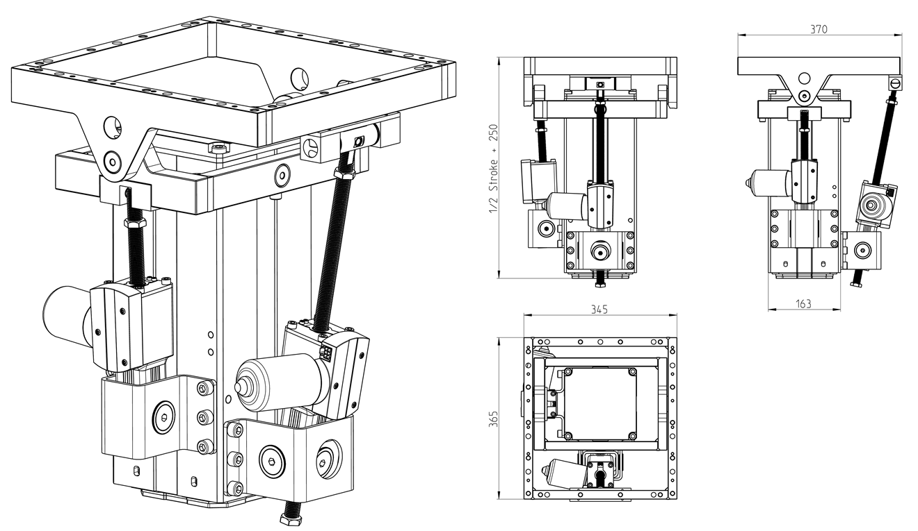
Surgical Module – Technical data 3/3 Main dimensions

Slide 5
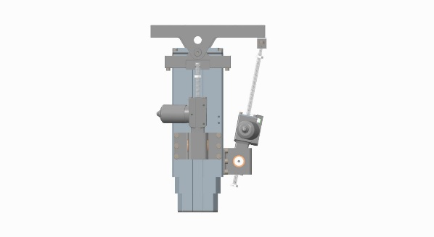
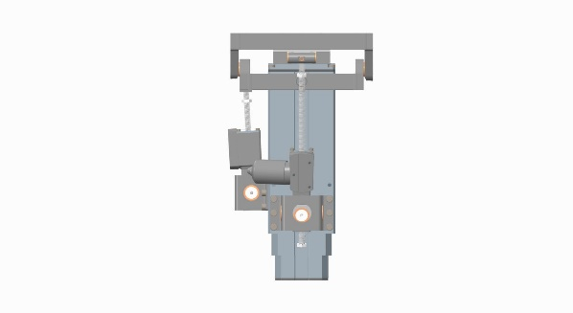
Surgical Module – Technical data 1/3
Longitudinal tilt(Trendelenburg)
+ 50°maximum - 50°
+ 45°combined - 45°
Module built in height 500 mm
Extended height 1000 mm
Lifting height capacity 500 mm (stroke)
Lifting force 5000 N
Standard tilt range in +/- 45° longitudinal extended position (up) +/- 30° lateral
Standard tilt range in + 3°/ - 45°longitudinal ¹ retracted position (down) +/- 30° lateral
Patient shift in + 250 mm to -150 mm longitudinal direction at maximum patient weight and maximum longitudinal tilt
Maximum module load 350 kg 350 kg
Thereof patient weight 250 kg 250 kg
Thereof table top weight 100 kg 100 kg
Lateral tilt
+ 30°maximum - 30°
+ 30°combined - 30°
+ Longitudinal patient shift -

Slide 6
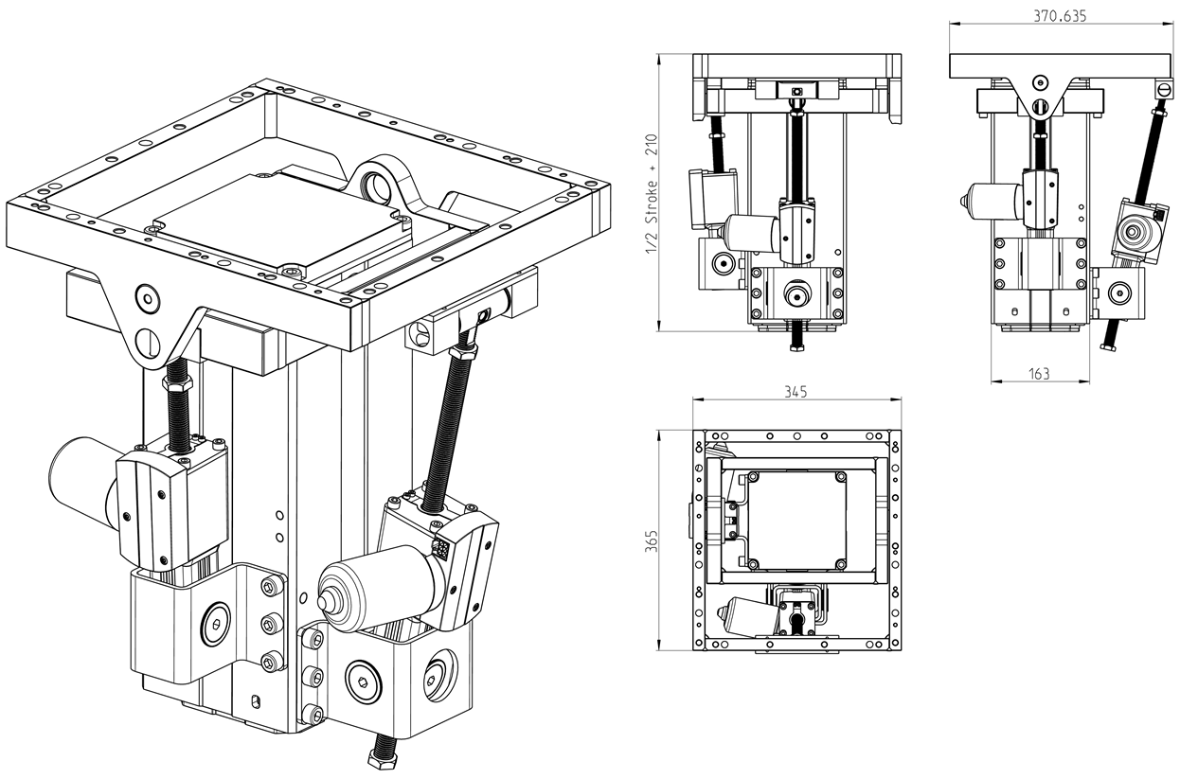
Surgical Module – Technical data 3/3 Main dimensions

Slide 7
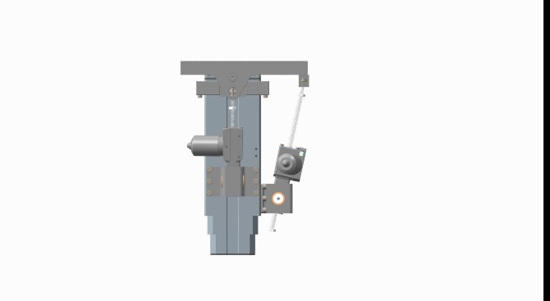
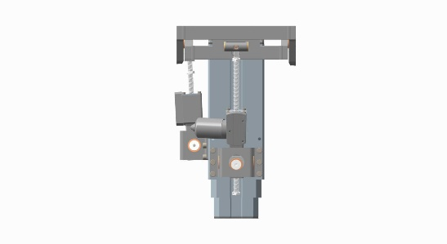
Surgical Module – Technical data 1/3
Longitudinal tilt(Trendelenburg)
+ 45°maximum - 45°
+ 40°combined - 40°
Module built in height 460 mm
Extended height 960 mm
Lifting height capacity 500 mm (stroke)
Lifting force 5000 N
Standard tilt range in +/- 45° longitudinal extended position (up) +/- 25° lateral
Standard tilt range in + 3°/ - 45°longitudinal ¹ retracted position (down) +/- 25° lateral
Patient shift in + 250 mm to -150 mm longitudinal direction at maximum patient weight and maximum longitudinal tilt
Maximum module load 350 kg 350 kg
Thereof patient weight 250 kg 250 kg
Thereof table top weight 100 kg 100 kg
Lateral tilt
+ 25°maximum - 25°
+ 20°combined - 20°
+ Longitudinal patient shift -

Slide 8
Surgical Module – Technical data 2/3
3 motions electrical: 24V
Patient weight: 250 - 300 kg
Total height (retracted) 500 mm
Lifting stroke: 500 mm
Lifting force max. 500 kg
Pillar size: 163 x 163 mm
Frame size: 345 x 365 mm
Actuator tilting force: 6 kN
Longitudinal tilt angel: +/- 45°combined and +/- 50°maximum ¹
Lateral tilt angel: +/- 30°combined and +/- 30°maximum ¹
¹ Combined = both tilting angels possible at the same time
Maximum = only one tilting angel at the same time
Retracted = limitation of longitudinal tilt in positive direction at lowest lifting position
Lifting speed: 14 - 34 mm/sec.
Tilting speed longitudinal: 45° in ~ 20 sec.
Tilting speed lateral: 25° in ~ 10 sec.
Actuator speed: ~ 6mm/sec.
Control box : 3 channels open, synchronization possible with collision free programming

